Slide 1

Sustainability Committee Meeting #4
March 31, 2025

Slide 2
Part 1: Committee Progress to Date
Part 2: Revenue Part 1: Spark Expansion
Part 3: Revenue Part 2: Events
Part 4: Review of Potential Expense Savings
Part 5: FLPS Recommendations for Committee
Agenda

Slide 3
Committee Progress to Date
Meeting 1: Financial Sustainability
  Reviewed sustainability financials, noting a decrease in operational expenses since 2021
  Pat Campbell Fund currently covering operating expenses, with a 2-3 year sustainability estimate at a deficit
  Discussed short-term and long-term impacts for financial sustainability
  Key Recommendation: Take action on short-term expense cuts while reviewing potential for increased profit from Spark and Events
Meeting 2: Spark Expansion
  Reviewed three Spark growth models:
    Maintain a single-location summer camp
    Expand to a second location
    Build a STEAM center
  Key recommendations for financial model revisions:
    Increase registration assumptions
    Require full-summer registration (no partial enrollments)
    Modify refund policies & increase non-refundable fees
    Evaluate the necessity & cost savings of weekly field trips
Meeting 3: Event Strategy & Development
  Defined five event categories to support fundraising and brand growth:
    Stewardship Events – Recognizing donors every 2-3 years
    Gala/Award Events – Dinner, auctions, corporate sponsorship opportunities
    Prep Events – Lead-up to fundraising campaigns with high energy, low budget
    Community Experiences – Fun, large-scale events for engagement & revenue
    Student Experiences – Mission-aligned, sponsorship-driven student/family events
  Discussed event planning framework, including: Vetting process for selecting events, board involvement & commitment, internal & external communication strategy, leveraging corporate Angel Sponsors to support participation
  Key recommendations: FLPS team to identify event strategy for 25-26 fiscal year

Slide 4
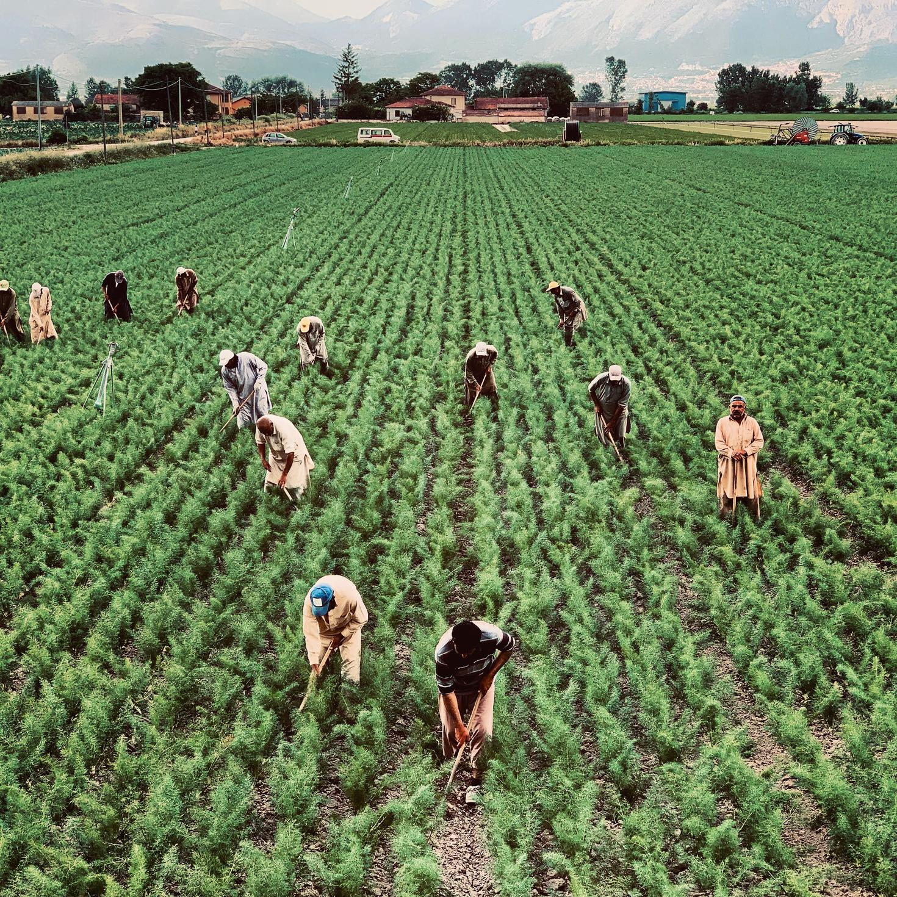

Revenue Planning - Spark
Expansion Opportunity Identified
  Spark committee deep dive explored potential growth opportunities
  Program Director identified a gap in middle school summer camp offerings, particularly in STEM/STEAM
  Proposed expansion would transform one site into a K-8 location instead of launching two separate sites for 25-26 fiscal year
  Spark to host an “Adults Go To Camp” Experience Each Year
Strategic Benefits of Expansion
  Increased revenue potential while managing costs effectively
  More efficient use of resources compared to operating two separate sites in year one
  Provides a seamless learning experience for students across multiple age groups
  Provide an evening for parents to enjoy the Spark experience
Financial Impact & Projections
  Projected middle school expansion profit: $29K at 96% enrollment
  Sponsorship packages developed to engage local businesses and offset program costs
    Sponsorship revenue potential: $27K ($3k per week of camp (conservative view))
  Adults Go To Camp: Projected $20k profit
  Total of $76k in potential profit 25-26
Next Steps & Implementation
  Finalize site logistics and curriculum for expanded age group
  Secure sponsorship commitments and partnerships
  Finalize Adults Go To Camp experience action plan
  Develop targeted marketing to drive enrollment and sponsorship sales

Slide 5


Revenue Planning - Events
Strategic Event Planning & Goals
  Internal review conducted to identify event opportunities that align with profit goals, brand growth, and mission support
  Events structured into two categories:
    Smaller Micro Events – Drive engagement and short-term giving
    Signature Event – Build major donor relationships and long-term support
Micro Event Strategy & Impact
  GTLD Pep Rally – Energize community giving during Give to Lincoln Day
    Target of $20k YOY growth from this one-week kick-off
  Give to LPS Day (new initiative) – Launched alongside a renewed Employee Giving Campaign.
    Community Giving Goal: $50K in year one
    Employee Giving Growth: Targeting 5% increase across LPS
    With just 400 employees donating $10, additional $4K raised with annual growth potential
  Total projected impact from micro events: $74K
Signature Event Strategy & Impact
    TCA Partnered Event or Gala/Auction
    Conservative revenue target: $50K in profit
    Long-term impact: Cultivating lifelong givers and major donors to support sustainable growth
Overall Financial Target & Long-Term Growth
  Total first-year event profit target: $124K
  Events designed to increase engagement, deepen donor relationships, and build lasting community support
  Ongoing evaluation to refine and expand event strategies for continued growth

Slide 6
Expense Reductions
Cuts We Should Make
Cuts We Could Make
Identified $11,000 annually in Operations in meals, gifts, underutilized dues/subscriptions and tech/support
Move to a biennial audit and do a review in the off years? Estimated savings: $5,625
Along with targeted operational revenue growth, we are committed to reviewing expenses monthly, quarterly, and annually to ensure we are operating efficiently, yet effectively.
After review of the four-year lookback and our current year trends, we have identified potential expense reductions to layer into the 25-26 budget, to support our sustainability goals.
Move to new investment firm. Estimated savings (minus cost of new Employee IRA program): $10k-$15k
Identified $3,500 from Development in staff gifts and campaign gifts
Four-Year Lookback
Identified $10,000 in potential marketing expense cuts - based on current trend and plans for next year
Evaluate and reduce features in current CRM/Donor Database Blackboard. Estimate Savings: $5,000

Slide 7
After review of potential revenue paths and expense reductions. We recommend the following:
  Implement Spark Middle School Expansion, Spark Sponsorships and Adults Go To Camp
    Projected Profit of $76k
  Launch mix of micro and signature events, plus revamped employee giving program
    Projected Profit of $124k
  Reduce expense in the “we should” and continue evaluation of the “we could” column
    Projected Expense Reduction: $24,500 to $50,125
  Evaluate new revenue profit lines and expenses on a regular basis to ensure they are achieving targets, align with mission and create a path for long-term sustainability.
Total Recommendations = $224,500 - $250,125
Recommendations for Sustainability

Slide 8
Thank You!

